Slide 1
Request
Requested Menu of Insights: Automotive Industry
Audience: Car buyers
Market: The UK
Vertical: Automotive

Slide 2
Key Highlights
  21.5% of car buyers were males in age group 25 to 34 years.
  44.4% of the retail purchasers belongs to high income group.
  54.7% of the car buyers used search engines for online product research between Q1 2024 and Q3 2025.
  38.7% of the car buyers considered Search engines for brand discovery in the UK between Q1 2024 and Q3 2025.
  Vehicle sales in the Passenger Cars were 1,812.0 thousand vehicles in the UK in 2024.
  Vehicle sales was highest for Ford with a share of 11.2% in the Passenger Cars in the UK in 2025.
  70% of the consumers in the UK responded that they own a car as of 2025.
  25% of the consumers in the UK responded that they intend to purchase a car as of 2025.

Slide 3
Limitations
Due to limited data available within our syndicated vendor tools, information on the following data points is not included in the report:
  growth patterns in these sub group industries in the automotive category however, industry insights for Passenger Cars have been covered.
Note:
GWI (which provides consumer insights) is updated till Q3 2025. Hence, insights have been covered for Q1 2024 - Q3 2025.

Slide 4
Understanding the Consumer
01

Slide 5
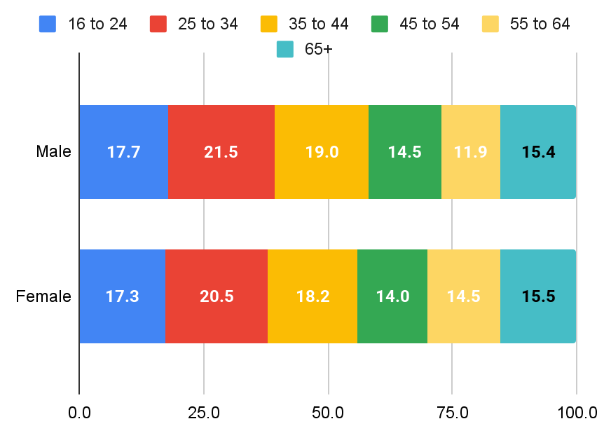
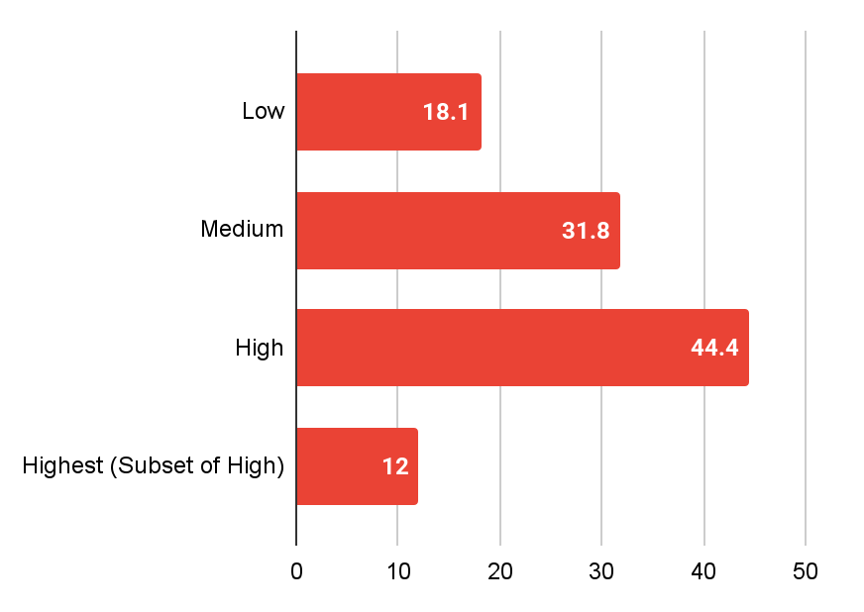
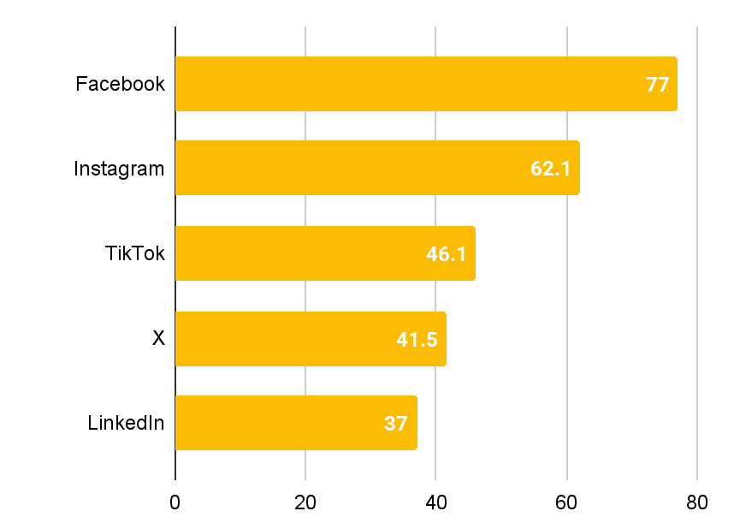
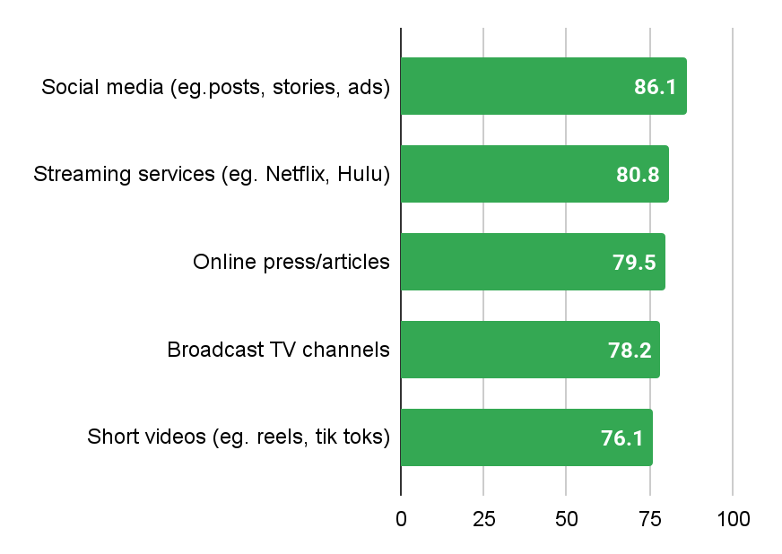
Consumer Overview Automotive (The UK)
Demographics (in %)
Income (in %)
Key Findings
21.5% of car buyers were males in age group 25 to 34 years.
44.4% of the retail purchasers belongs to high income group.
77% of the car buyers mostly used Facebook among all social media channels between Q1 2024 and Q3 2025.
86.1% of the car buyers were users of Social media (eg.posts, stories, ads) between Q1 2024 and Q3 2025.
Social Media Consumption (in %)
Media Users Segmentation (in %)
Source : GWI

Slide 6
Brand Consideration
02

Slide 7
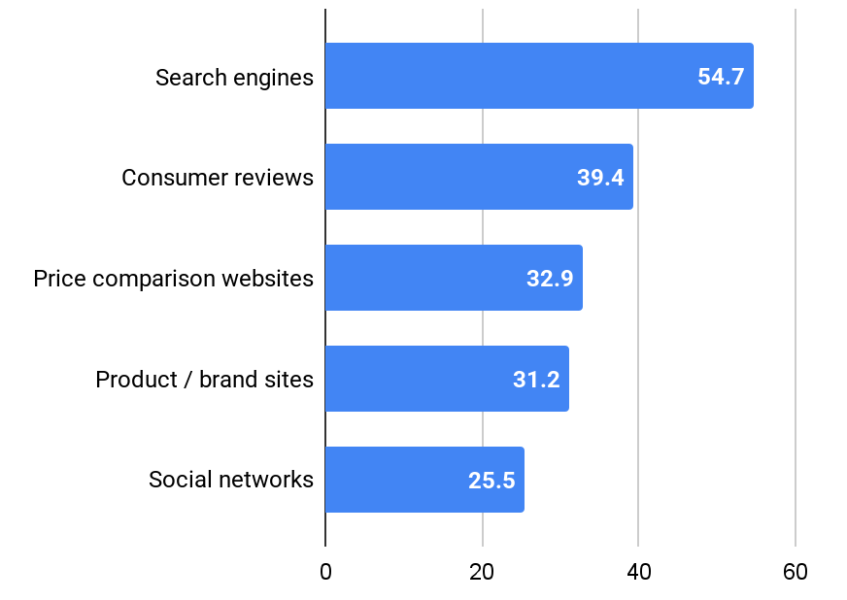
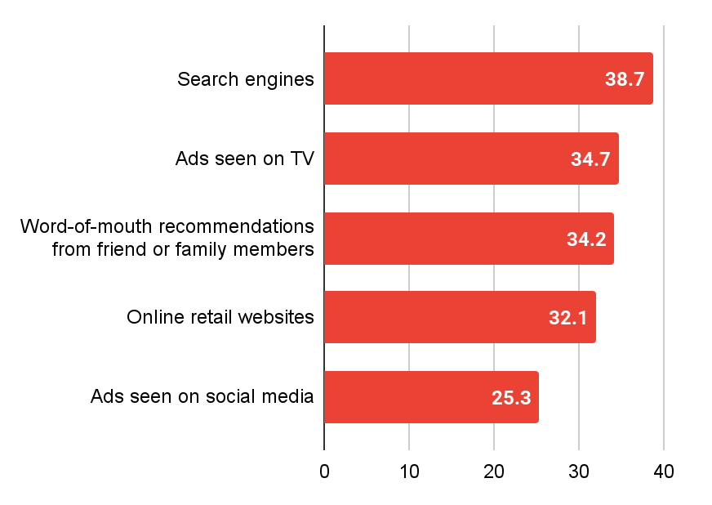
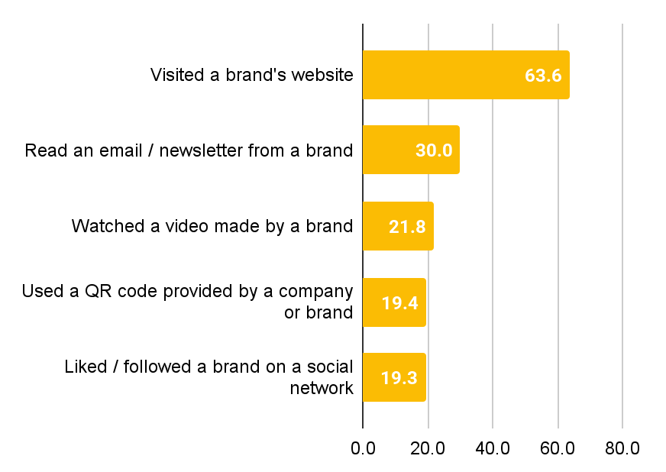
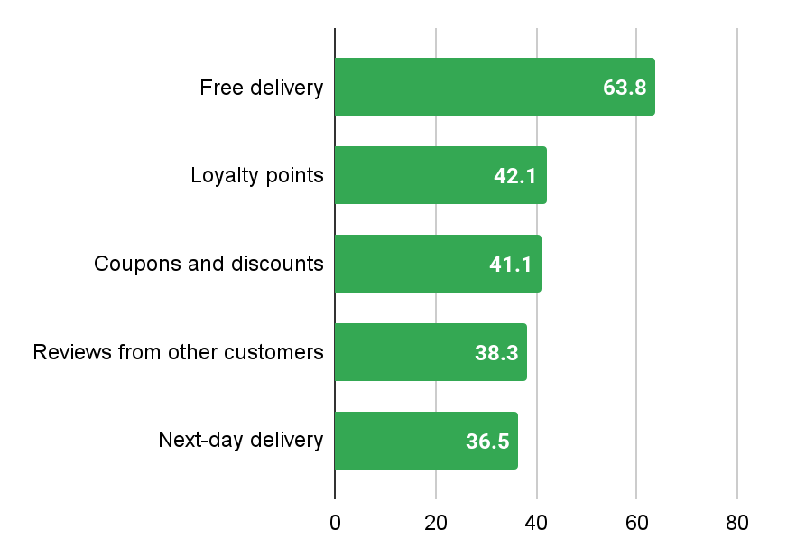
Online Purchase Journey Marketing Touchpoints (the UK)
Online Product Research (in %)
Brand Discovery (in %)
Key Findings
54.7% of the car buyers used search engines for online product research between Q1 2024 and Q3 2025.
38.7% of the car buyers considered Search engines for brand discovery in the UK between Q1 2024 and Q3 2025.
63.6% of the car buyers visited the brand’s website for online brand interaction between Q1 2024 and Q3 2025.
63.8% of the car buyers considered free delivery was an important online purchase drivers between Q1 2024 and Q3 2025.
Online Brand Interactions (in %)
Online Purchase Drivers (in %)
Source : GWI

Slide 8
Industry Insights
03

Slide 9
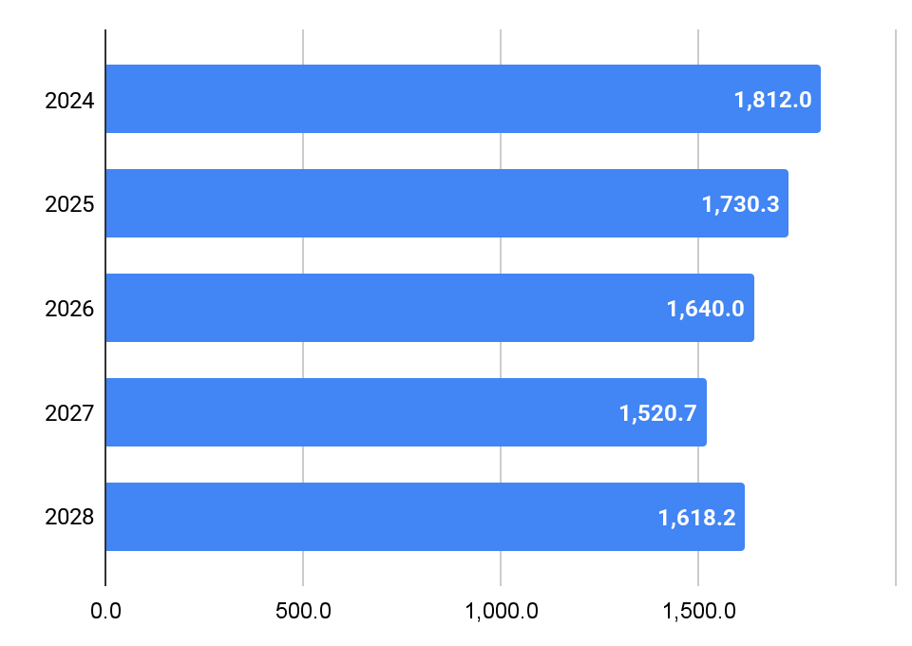
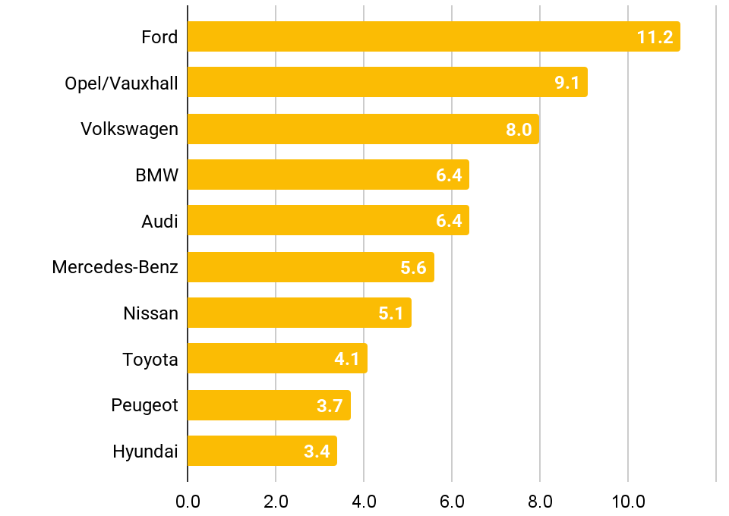
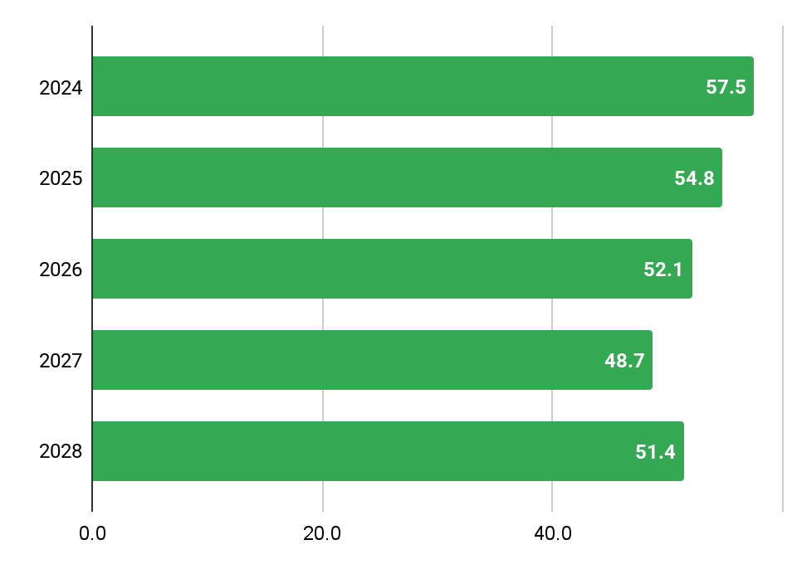
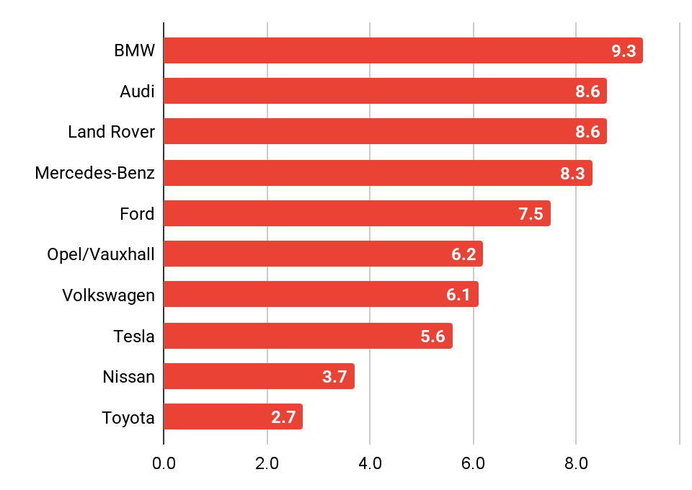
Industry Overview & Market Trends Passenger Cars (The US)
Key Findings
Vehicle Sales (in thousand vehicles)
Vehicle Sales by Make (in %)
Vehicle sales in the Passenger Cars were 1,812.0 thousand vehicles in the UK in 2024.
Vehicle sales was highest for Ford with a share of 11.2% in the Passenger Cars in the UK in 2025.
Revenue in the Passenger Cars market amounts to US$54.8B with BMW leading with a share of 9.3% in 2025 in the UK.
Revenue (in US$ B)
Revenue by Make (in %)
Syndicated Reports
Car financing and leasing in the United Kingdom, 2025
Automotive Industry in the United Kingdom, 2024
Source : Statista

Slide 10
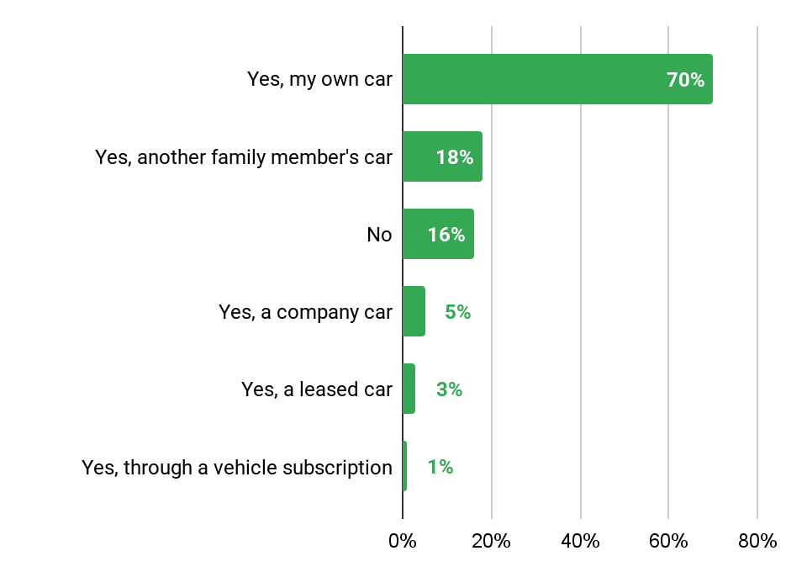
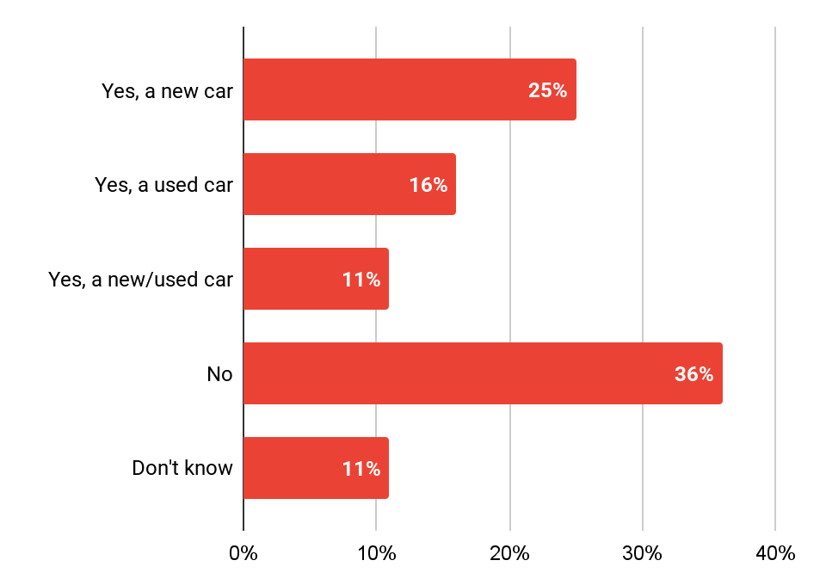
Industry Overview & Market Trends Passenger Cars (The US)
Key Findings
Car ownership (in %)
Car purchase intention (in %)
70% of the consumers in the UK responded that they own a car as of 2025.
25% of the consumers in the UK responded that they intend to purchase a car as of 2025.
Source : Statista

Slide 11
Data Sharing Guidelines
GWI Internal & External sharing clause We can share findings from the data internally and externally as long as it is properly referenced. Please can you quote the following when using GWI data. “Unless otherwise stated, all figures are taken from GlobalWebIndex Q1 2024 - Q3 2025 wave(s) of online research among internet users in the UK”. Publicity Neither party may make any public statement regarding this Agreement without the other’s prior written approval. To view details on audience profile kindly refer here. GWI Metrics Explained : Audience % shows how many people in your audience match with the data point. The Universe shows GlobalWebIndex estimates of how many real-world people are represented by the Audience %. Responses show the number of people from our panel who match with the data point.
Request a slide at go/AHA-consult and ready-to-pitch in 24-48 hours

Slide 12
Data Sharing Guidelines
Statista Internal and external sharing clause The rights granted exclusively to Authorized Users are as follow: (a) The right to use Materials for research purposes only, and the right to copy Materials into users’ analyses, presentations, documents, and other similar forms of work or research material; that includes printing, and archiving of statistics for internal and external purposes in the normal course of business and a fair use of downloaded statistics; (b) The right to publish and distribute Derived Data (defined below) internally and externally, “Derived Data” shall mean any information, algorithm, model, index, score or data resulting from your manipulation or analysis of the Materials and/or combination with other data not provided by Statista, such that the underlying data is not discernable as being that of Statista, - Notwithstanding the foregoing, you shall not directly or indirectly resell the Materials or Derived Data to third parties; (c) For the avoidance of doubt, downloading and storing materials in an archival database is prohibited. (d) The right to Email, fax, download or make printouts using the commands of the Online Services and the right to create a single printout of Materials accessed or downloaded by any other lawful means (collectively, “Authorized Printouts”); Publicity Neither party shall use the name, trademarks, service marks, symbols, or logos of the other party without the express prior written consent of the other party
Request a slide at go/AHA-consult and ready-to-pitch in 24-48 hours

